Slide 1

Customer Shopping Behavior Analysis
Uncovering insights from 3,900 purchases to guide strategic business decisions

Slide 2
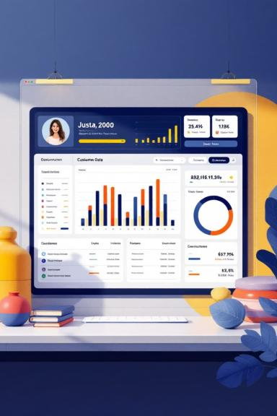
Dataset Overview
3,900
18
37
Purchase Records
Data Fields
Missing Values
Transactional data analyzed
Customer, purchase, and behavior metrics
Review ratings imputed

Slide 3

Python Data Preparation
Data Cleaning
Feature Engineering
Imported with pandas
Checked structure and statistics
Handled missing review ratings
Standardized column names
Created age groups
Calculated purchase frequency
Dropped redundant promo codes
Loaded to PostgreSQL

Slide 4


Revenue by Gender
73%
27%
Male Customers
Female Customers
$157,890 revenue
$75,191 revenue

Slide 5

Top Products by Rating
Gloves
3.86 average rating
Sandals
3.84 average rating
Boots
3.82 average rating
Hat
3.80 average rating

Slide 6

Shipping & Discount Insights
Express Shipping
Standard Shipping
$60.48 average purchase
$58.46 average purchase
High-Spending Discount Users
839 customers used discounts above average

Slide 7


Subscription Impact
27%
73%
Subscribers
Non-Subscribers
1,053 customers
2,847 customers
Subscriber Average
Non-Subscriber Average
$59.49 per purchase
$59.87 per purchase
$62,645 total revenue
$170,436 total revenue

Slide 8
Discount-Dependent Products
1
2
3
Hat
Sneakers
Coat
50.00% discounted
49.66% discounted
49.07% discounted
4
5
Sweater
Pants
48.17% discounted
47.37% discounted

Slide 9
Customer Segmentation
Loyal
3,116 customers
Returning
701 customers
New
83 customers

Slide 10

Strategic Recommendations
Boost Subscriptions
Promote exclusive subscriber benefits
Loyalty Programs
Reward repeat buyers
Review Discount Policy
Balance sales with margins
Targeted Marketing
Focus on high-revenue segments

